Slide 1







GoF Gonna Give You Up...
Home
Content
Live Demo
Conclusion
GITHUB REPO QR

Slide 2

GoF Gonna Let You Down...
Home
Content
Live Demo
Conclusion
PDF QR CODE

Slide 3


GoF Gonna Run Around...
Home
Content
Live Demo
Conclusion
Introduction to
TIVIDY
WORKFLOW ENGINE

Slide 4
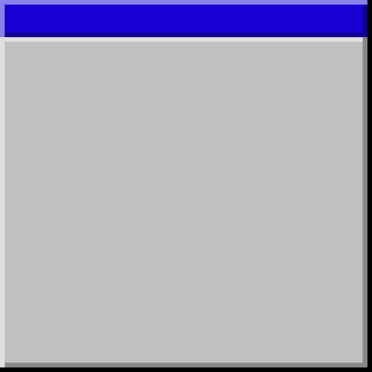



And Desert You...
...
Home
Content
Live Demo
Conclusion
THIS IS A
SIMULATION FOR A WORKFLOW
MANAGEMENT SYSTEN
e
The generic and specific scenario systems do not reflect actual industry workflows.

Slide 5





GoF Gonna Make You Cry...
...
Home
Content
Live Demo
Conclusion
CONTENT
  Project Scope
  Backend
    UML Class Diagram
    Design Pattern Uses
      Why and How
  GitHub
    GitHub Actions
  Doxygen and Docker
  Tests
  Scenarios
  Frontend
    Live Demo

Slide 6

GoF Gonna Say Goodbye...
..
Home
Content
Live Demo
Conclusion
PROJECT SCOPE
TIVIDY is a flexible engine built in C++ that brings workflow definitions to life as independent, real-time instances. It coordinates tasks, tracks state, and manages dynamic routing while keeping every process completely isolated.

Slide 7


GoF Gonna Tell A Lie...
Home
Content
Live Demo
Conclusion
BACKEND

Slide 8
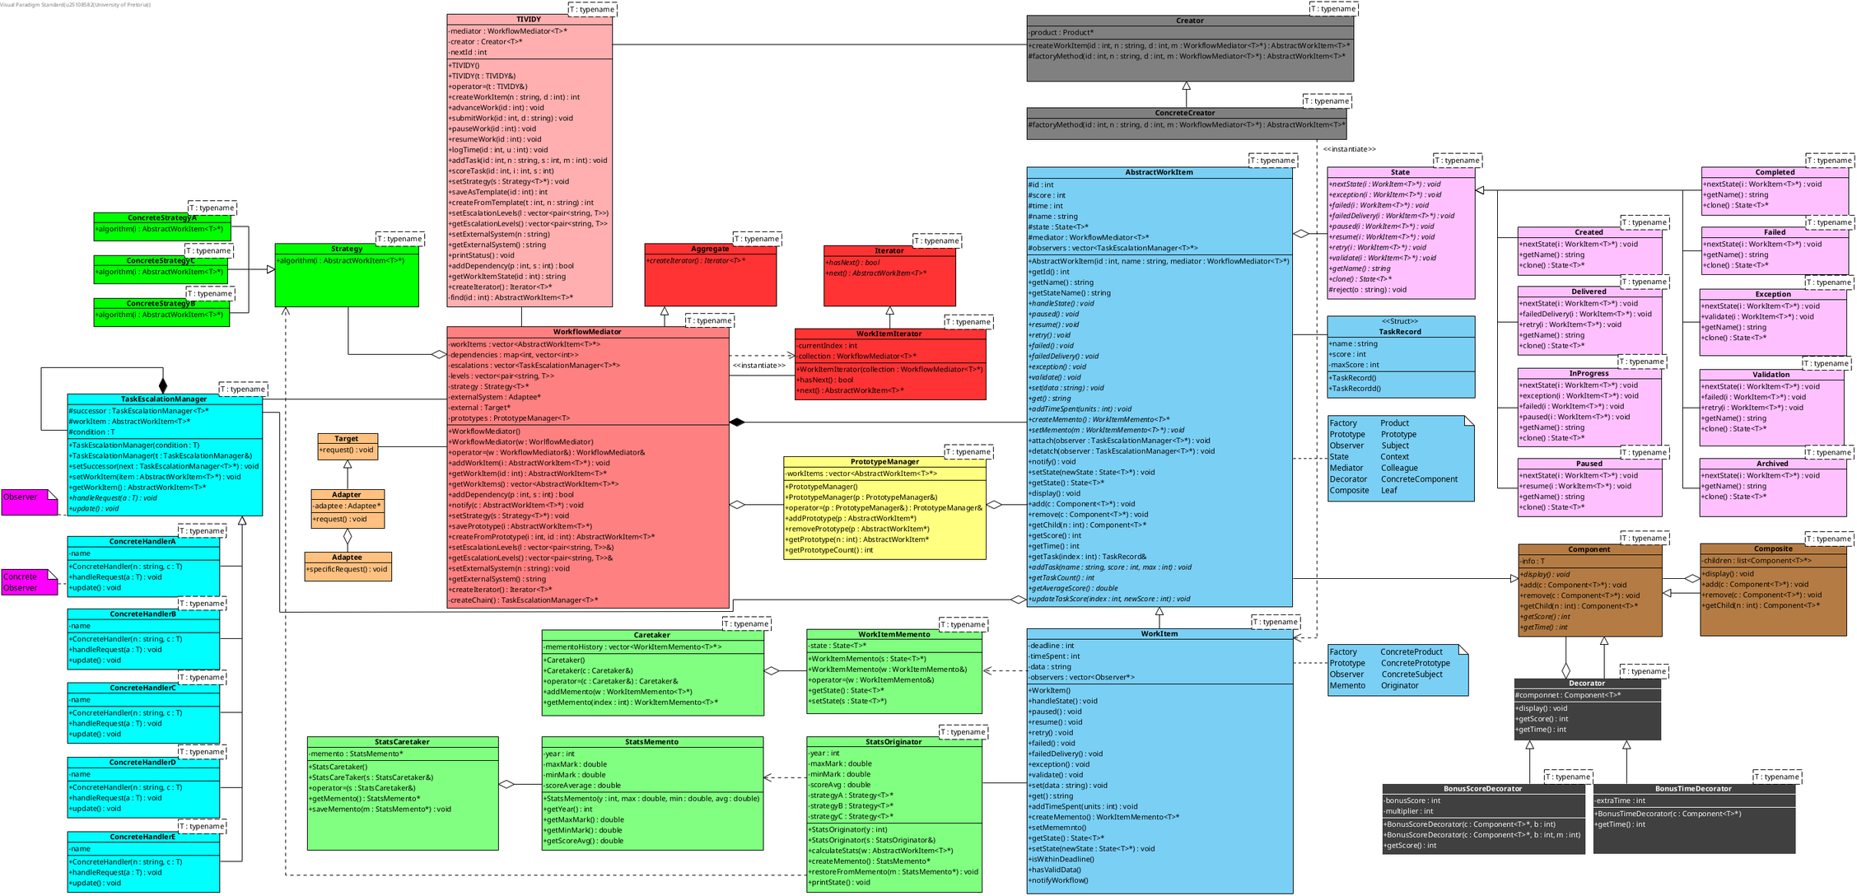

Slide 9


And Hurt You...
Home
Content
Live Demo
Conclusion
PATTERNS
  Facade
  Factory Method
  Mediator
  Strategy
  Prototype
  Adapter
  Chain of Responsibility
  Observer
  Composite
  Decorator
  State
  Memento

Slide 10
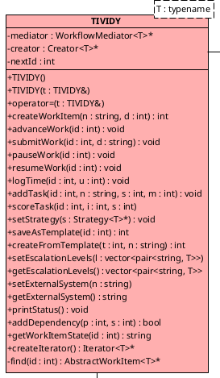
GoF Gonna Give You Up...
Home
Content
Live Demo
Conclusion
FACADE
The Facade pattern is used to give our system a single, simple front door through the TIVIDY class, hiding all the underlying complexity.

Slide 11
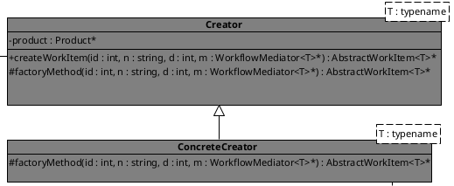
GoF Gonna Let You Down...
.
Home
Content
Live Demo
Conclusion
FACTORY
Factory Method handles creating WorkItem behind the scenes, keeping the rest of the system decoupled from specific object instantiation.

Slide 12
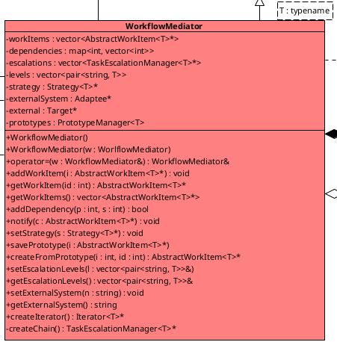
GoF Gonna Run Around...
Home
Content
Live Demo
Conclusion
MEDIATOR
The Mediator acts as a traffic controller, letting work items, adapters, and the main system talk to each other without tying everything into a tangled mess.

Slide 13
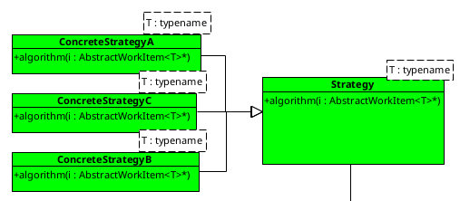
And Desert You...
Home
Content
Live Demo
Conclusion
STRATEGY
The Strategy pattern lets us swap out statistical algorithms on the fly whenever we need to calculate different stats for a work item.

Slide 14
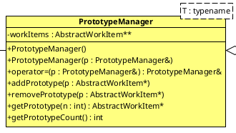
GoF Gonna Make You Cry...
Home
Content
Live Demo
Conclusion
PROTOTYPE
With the Prototype pattern, our PrototypeManager can clone existing WorkItem whenever we need fresh copies without having to rebuild them from scratch.

Slide 15
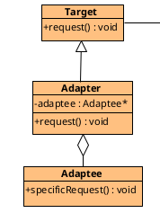
GoF Gonna Say Goodbye...
Home
Content
Live Demo
Conclusion
ADAPTER
The Adapter pattern acts as a bridge, taking an external system and translating it into a format our system understands.

Slide 16
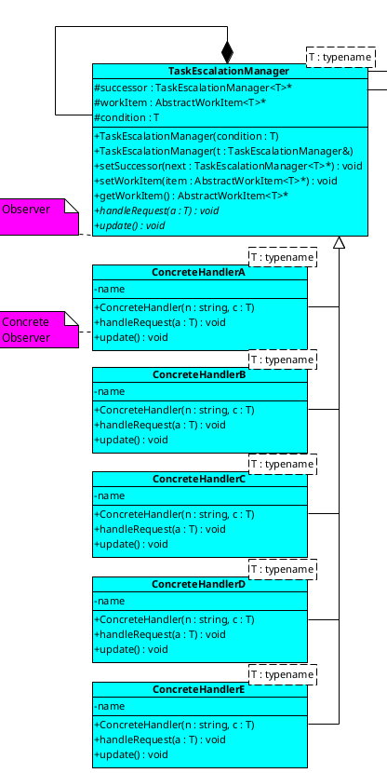
GoF Gonna Tell A Lie...
Home
Content
Live Demo
Conclusion
CHAIN
The Chain of Responsibility passes a WorkItem down a line of handlers when something changes, letting the right handler step up and process it.

Slide 17
And Hurt You...
Home
Content
Live Demo
Conclusion
OBSERVER
The Observer pattern keeps an eye on WorkItem and automatically alerts our Chain of Responsibility the moment a state change happens.

Slide 18
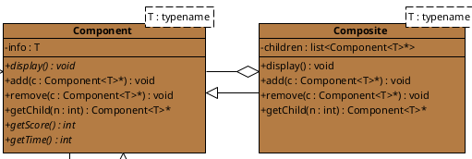
Ooh (Give you up)...
Home
Content
Live Demo
Conclusion
COMPOSITE
The Composite pattern organizes our components into a WorkItem hierarchy.

Slide 19
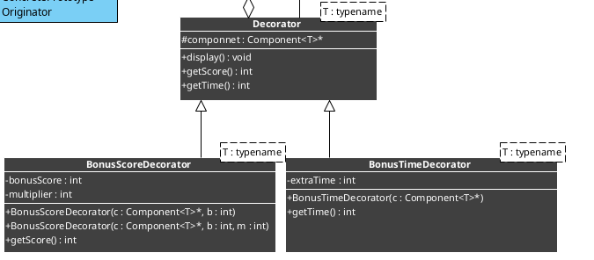
Ooh-ooh (Give you up)...
Home
Content
Live Demo
Conclusion
DECORATOR
The Decorator pattern lets us wrap the WorkItem with extra features like bonus scores and additional time.

Slide 20
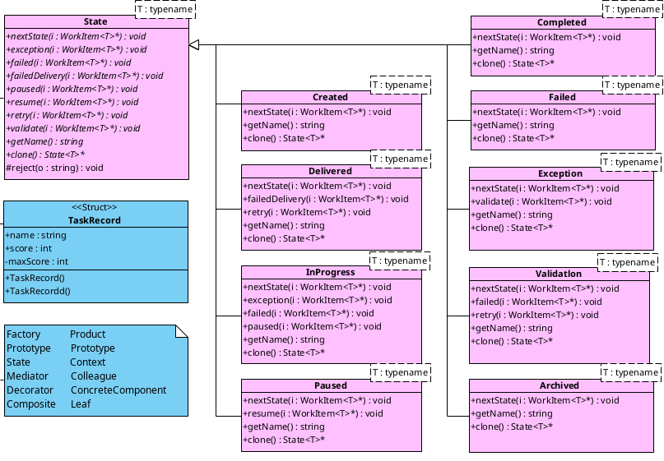
Ooh (GoF Gonna Give, GoF Gonna Give)...
Home
Content
Live Demo
Conclusion
STATE
The State pattern allows to control the lifecycle of the WorkItem.

Slide 21
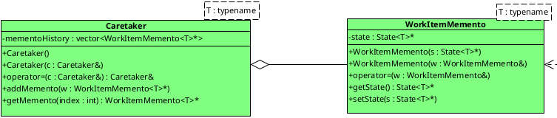
Give you up...
Home
Content
Live Demo
Conclusion
MEMENTO.1
We used the Memento pattern with WorkItemMemento to take snapshots of a WorkItem's current state, allowing us to safely restore its progress whenever needed.

Slide 22
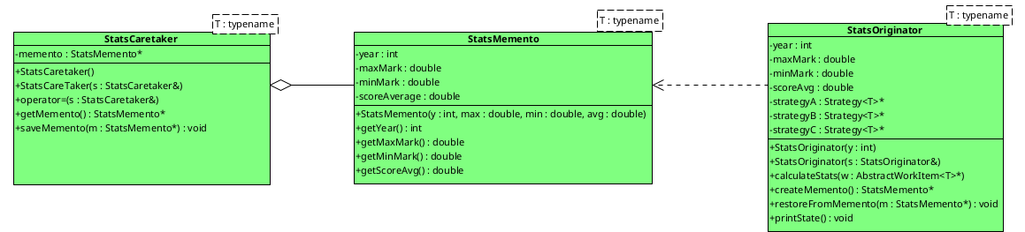
Ooh-ooh (Give you up)...
Home
Content
Live Demo
Conclusion
MEMENTO.2
Memento.2 uses the Strategy pattern to caluclate statistics from the WorkItem and saves a snapshot of the statistics.

Slide 23


Ooh-ooh (Never gonna give, never gonna give)...
Home
Content
Live Demo
Conclusion
Commit
GITHUB
Pull

Slide 24
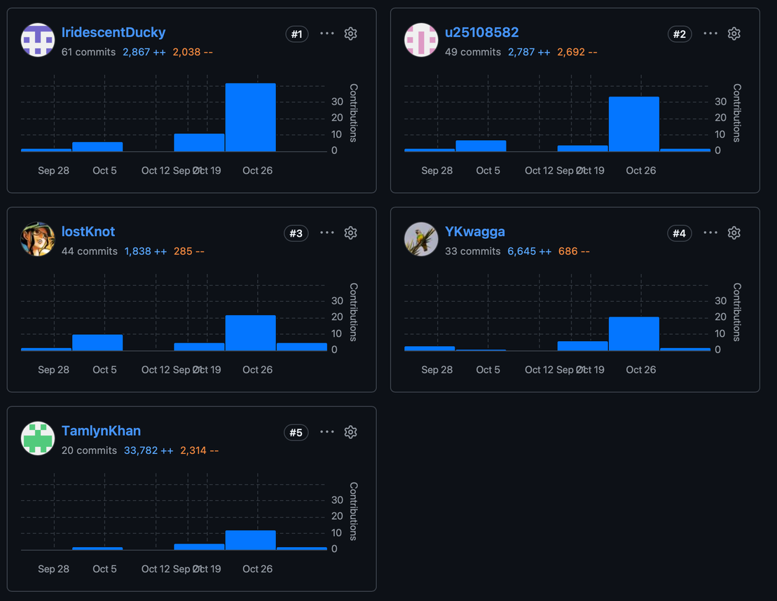
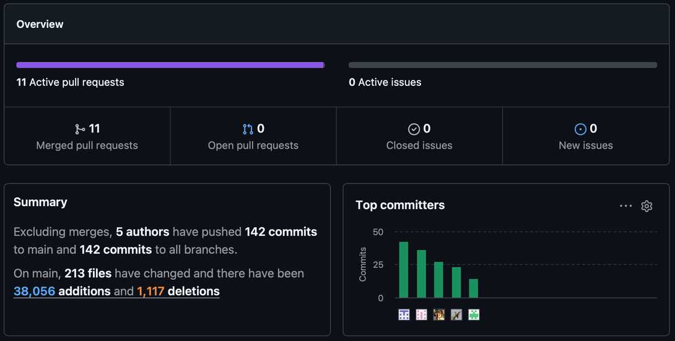
Give you up...
Home
Content
Live Demo
Conclusion

Slide 25
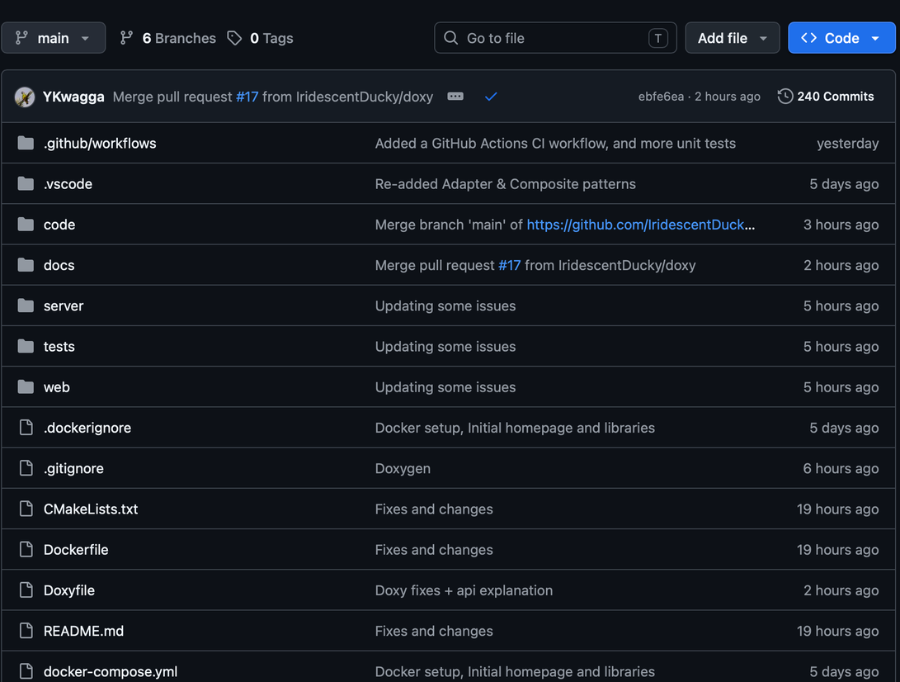
We've known each other for so long...
Home
Content
Live Demo
Conclusion

Slide 26


Your heart's been aching...
Home
Content
Live Demo
Conclusion
DOXYGEN

Slide 27
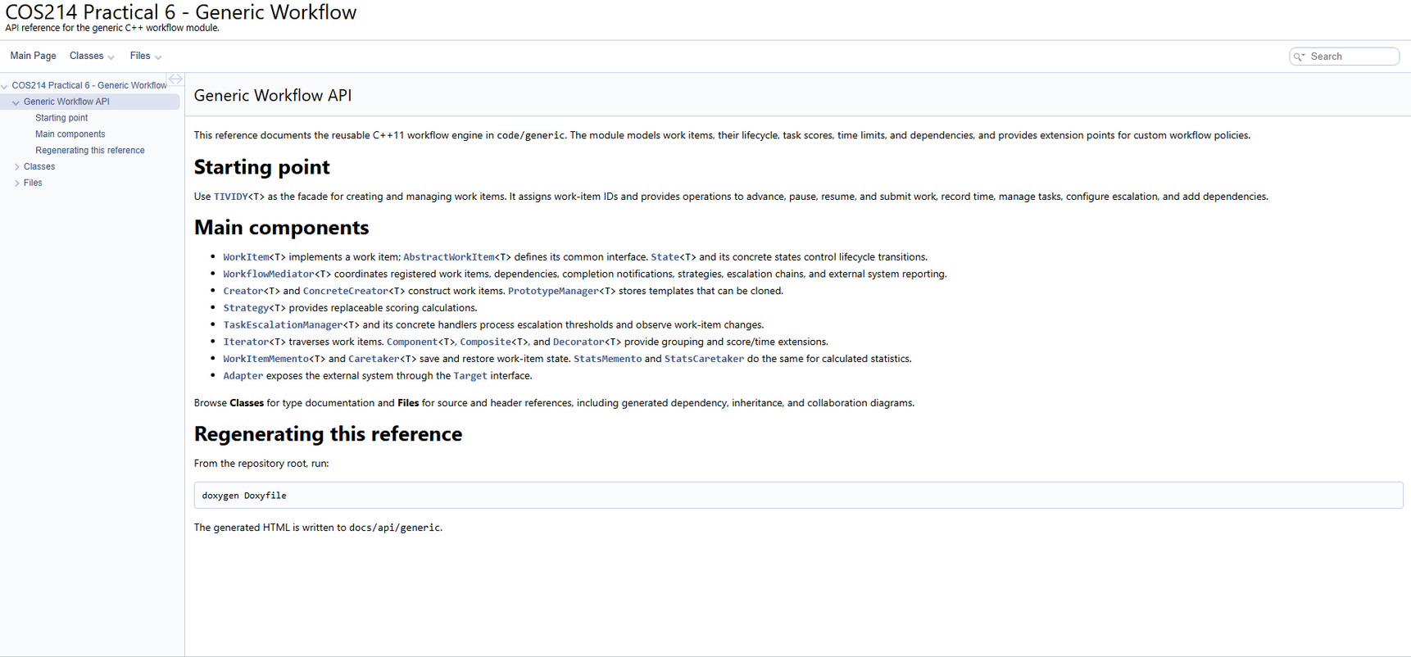
but you're too shy to say it...
Home
Content
Live Demo
Conclusion

Slide 28
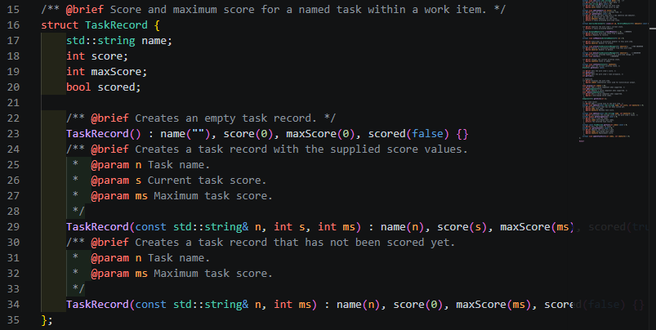
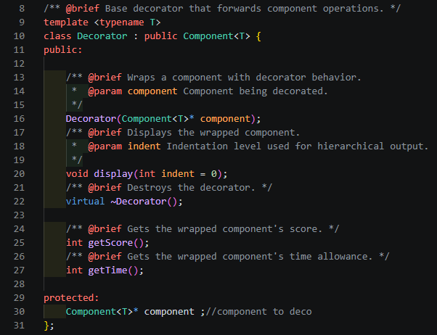
Inside, we both know what's been going on...
Home
Content
Live Demo
Conclusion

Slide 29
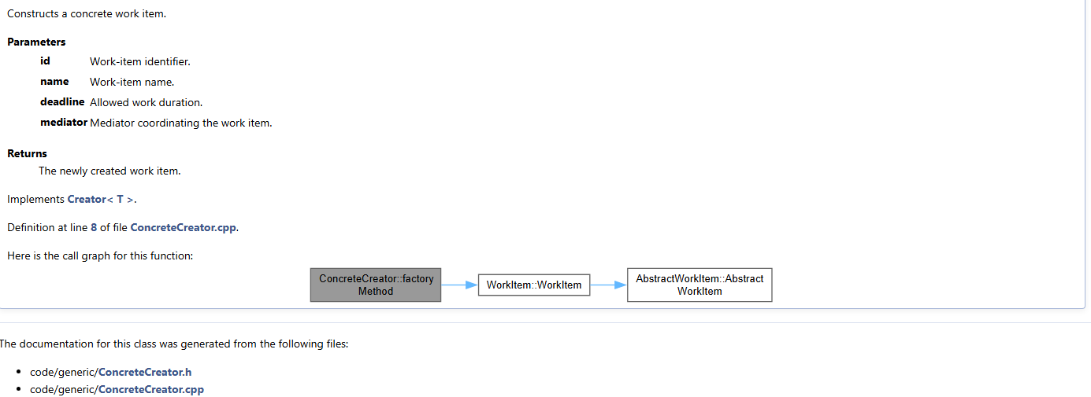
We know the game...
Home
Content
Live Demo
Conclusion

Slide 30


and we're gonna play it...
Home
Content
Live Demo
Conclusion
DOCKER

Slide 31
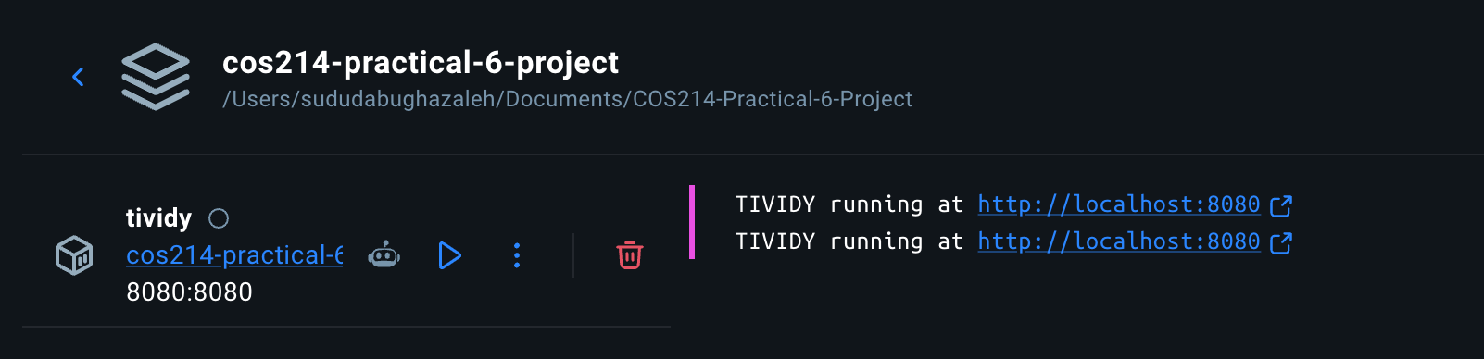
I just wanna tell you how I'm feeling...
Home
Content
Live Demo
Conclusion

Slide 32
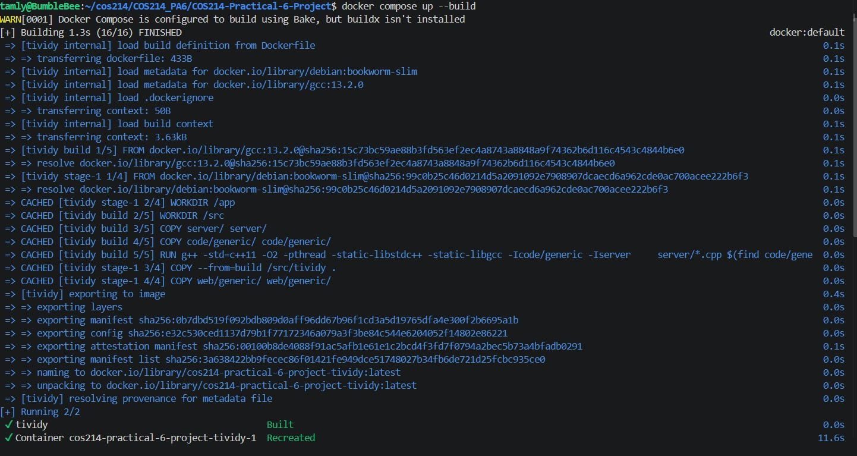
Gotta make you understand...
Home
Content
Live Demo
Conclusion

Slide 33
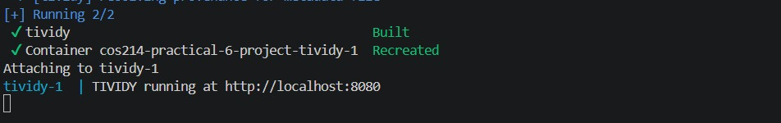
GOF Gonna Give You Up...
Home
Content
Live Demo
Conclusion

Slide 34


GOF Gonna Let You Down...
Home
Content
Live Demo
Conclusion
TESTS

Slide 35
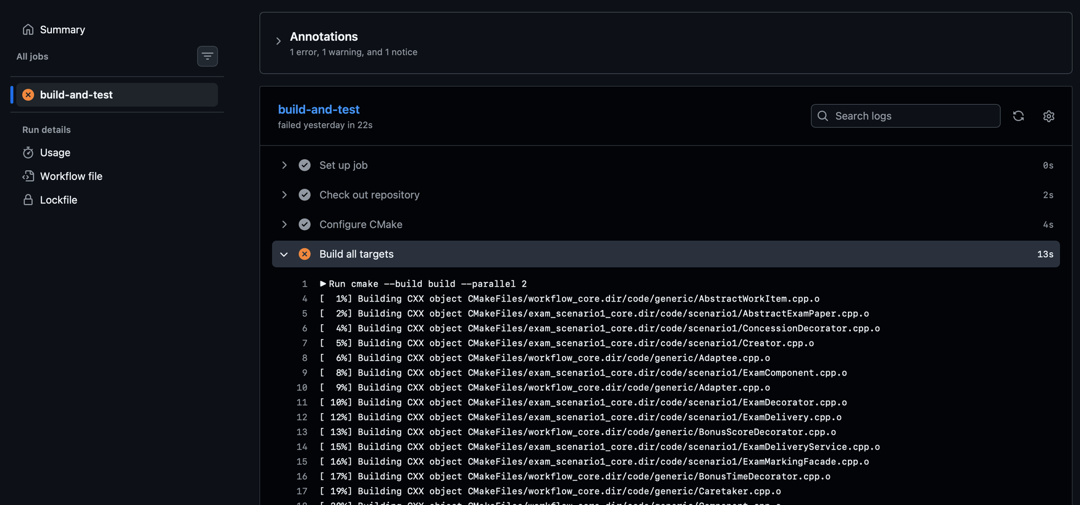
GOF Gonna Run Around...
Home
Content
Live Demo
Conclusion

Slide 36
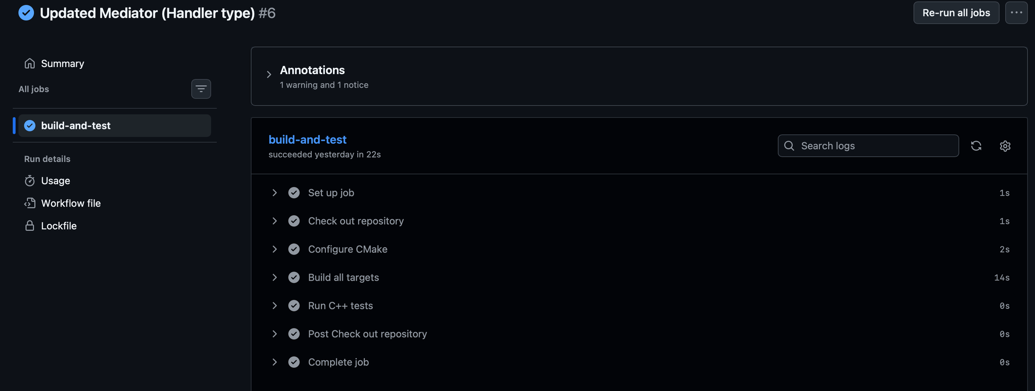
And Desert You...
Home
Content
Live Demo
Conclusion

Slide 37
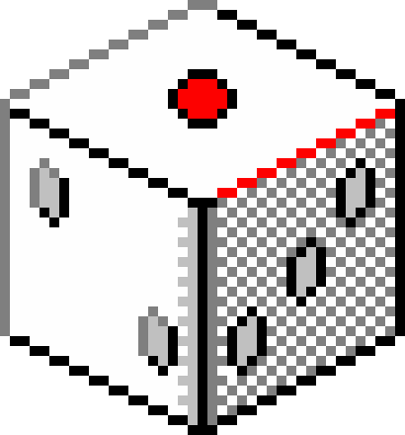

GOF Gonna Make You Cry...
Home
Content
Live Demo
Conclusion
SCENARIOS

Slide 38
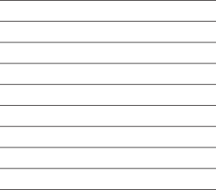
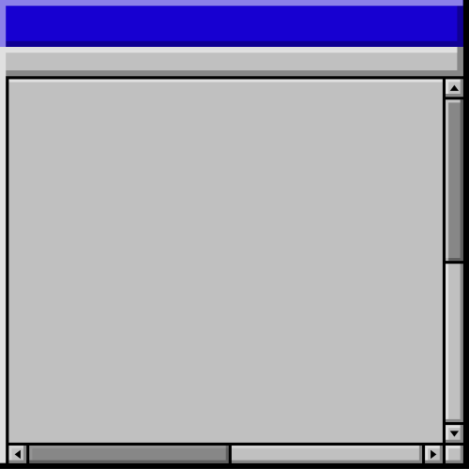



GOF Gonna Say Goodbye...
Home
Content
Live Demo
Conclusion
EXAM SCENARIO

Slide 39
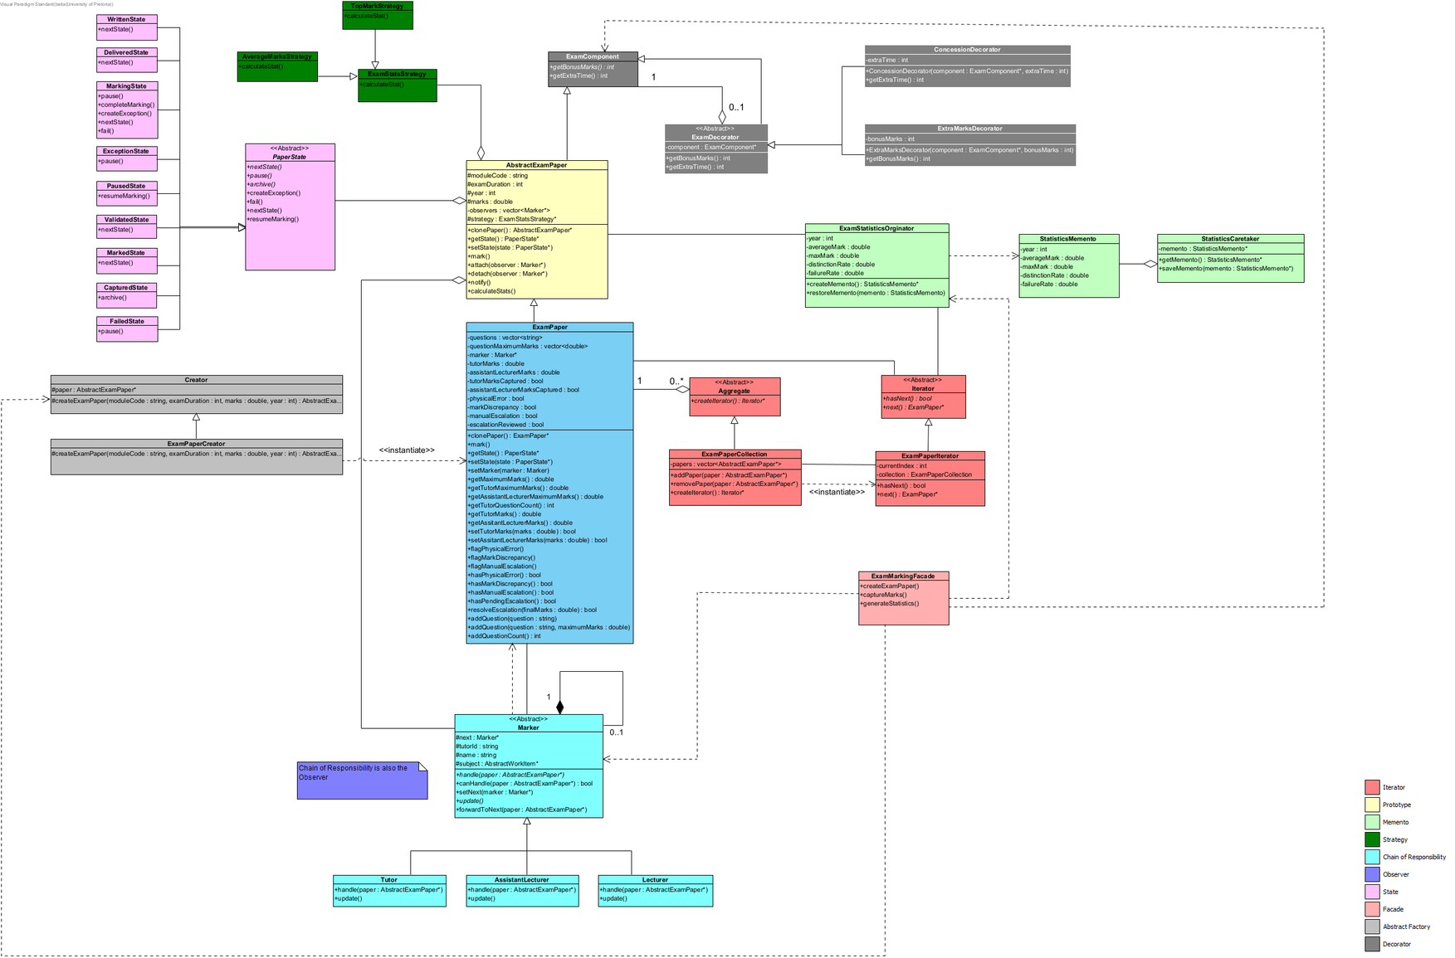

Slide 40





GOF Gonna Tell A Lie...
Home
Content
Live Demo
Conclusion
GAME SCENARIO

Slide 41
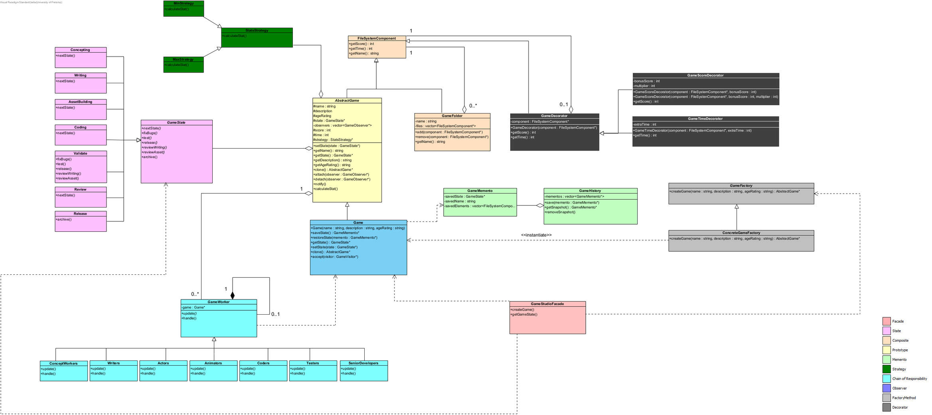

Slide 42


And Hurt You...
Home
Content
Live Demo
Conclusion
DISCLAIMER:
AI WAS USED TO ASSIST MAKING OUR FRONTEND

Slide 43

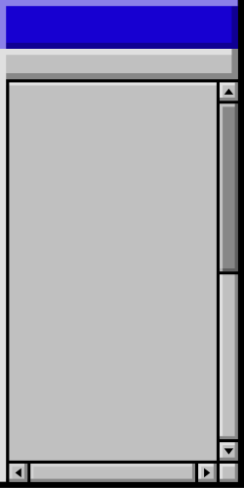

Ooh-ooh (Give you up)...
Home
Content
Live Demo
Conclusion
FRONTEND

Slide 44



Ooh (Never gonna give, never gonna give)...
Home
Content
Live Demo
Conclusion
LIVE DEMO

Slide 45

Give you up.
Home
Content
Live Demo
Conclusion
CONCLUSION
http://localhost:8080
@GoF_RickRoll
Just sing the song

